Slide 1

Progress Report
on
“E-Learning System for an Employee”
Submitted By
Deepankar (201500093)
Arijeet Acharyya (201500115)
Under the guidance of
Rohini N.
Infosys Ltd, Mysore
Under the Internal guidance of
Suman Kalyan Kar
Assistant Professor-I
Computer Science and Engineering

Slide 2
CONTENTS
Abstract
Introduction
Problem Definition
Solution Strategy
Diagrams
Progress

Slide 3
1. ABSTRACT
Web based applications are programs that are accessed over a network connection using HTTP.
Companies these days use online platform to train employees in various courses that employees are subjected to use when deployed to a project.
The training and performance assessment of each employee is to be done online.
Technology: Visual Studio 2017, SQL Server 2016, Angular CLI, Node.js

Slide 4
2. INTRODUCTION
A web based application deals with online training program for employees of the company.
The application basically lists out the courses available and time in which the courses has to be completed.
It even makes the task of the company easier to review the courses and the training done by the employees.
The company can assess the performance of each employee by conducting online exam for the course.

Slide 5
3. PROBLEM DEFINITION
The project is to develop an E-learning system for an employee.
In the present context providing a training and making employee project ready is a tedious task and involves time and resource.
The process of evaluation of assessment and course review is required but is not available.

Slide 6
4. SOLUTION STRATEGY
A database is maintained involving entities and relationships between them
The data is fetched from and into the database using entity framework and web services.
Angular framework is used to build the single page application.

Slide 7
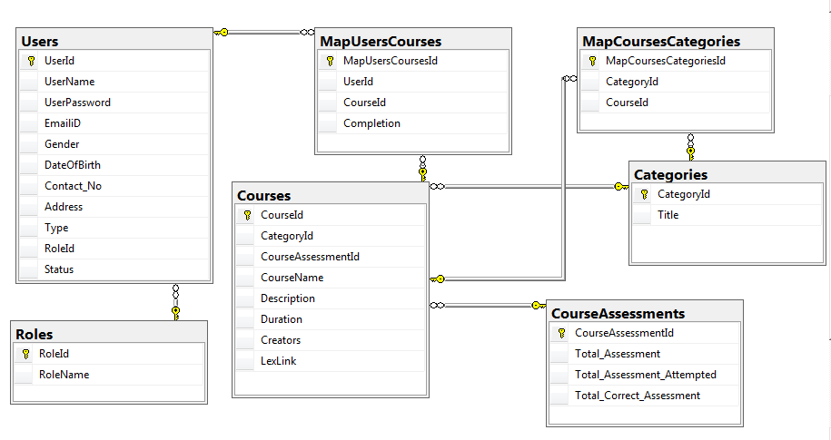
5. DIAGRAMS
Fig. 6.1 Database Diagram

Slide 8
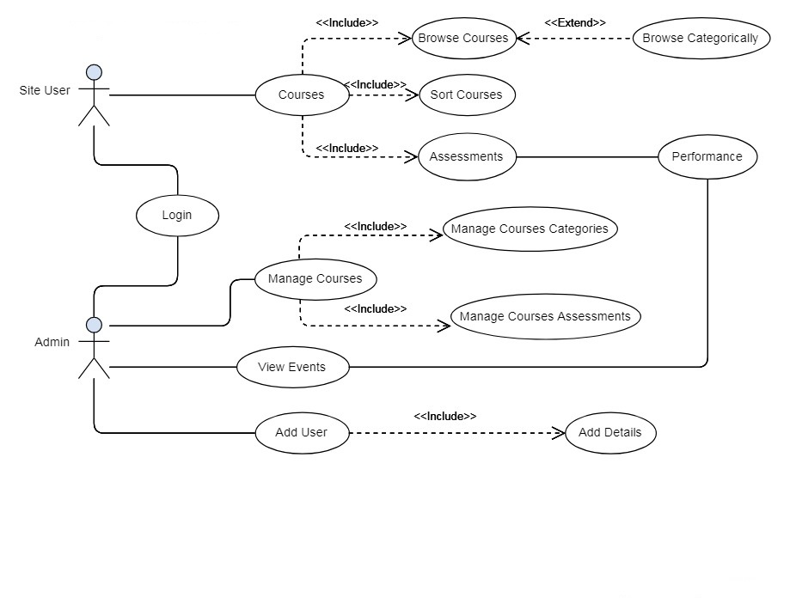
Fig. 6.2 Use Case Diagram

Slide 9
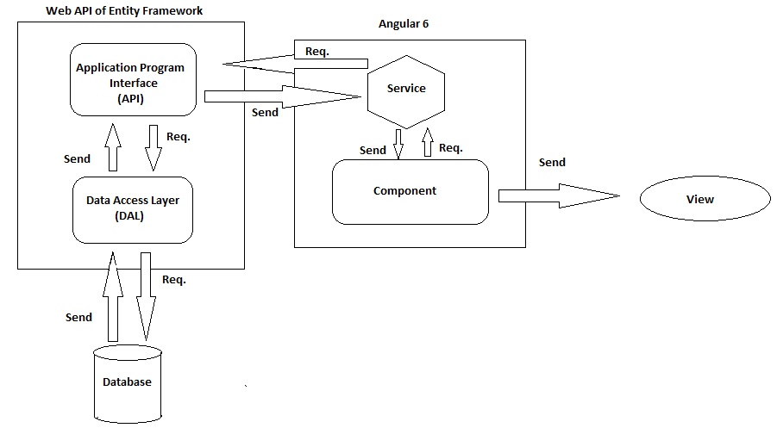
Fig. 6.3 Work Flow Diagram

Slide 10
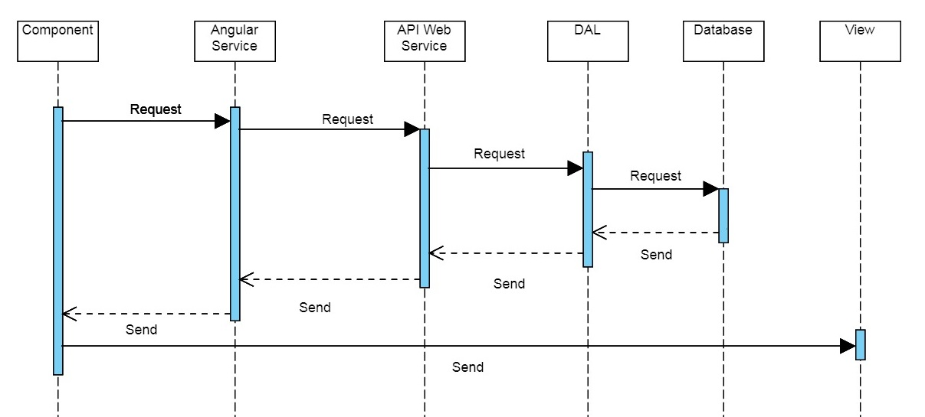
Fig. 6.4 Sequence Diagram

Slide 11
7. PROGRESS
As of now eight out of fourteen modules have been completed and their implementation are listed below:
1. Registration and Login:
As it is an intra-Elearning site within an organization, only admin is authorized to register a user and then the users can login.
The registration form filled is posted to the database by passing the data from the service method of the angular to the API method of web service and then to then the register method of the data access layer.
For login, the user details are fetched in similar manner and then validated with the user entry to redirect to the home page based on the roles thus, role based login.

Slide 12
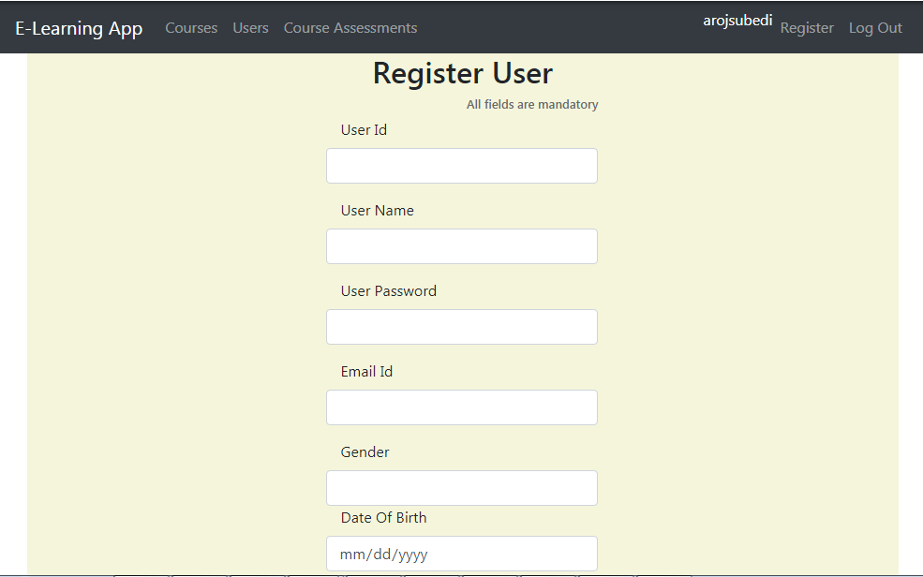
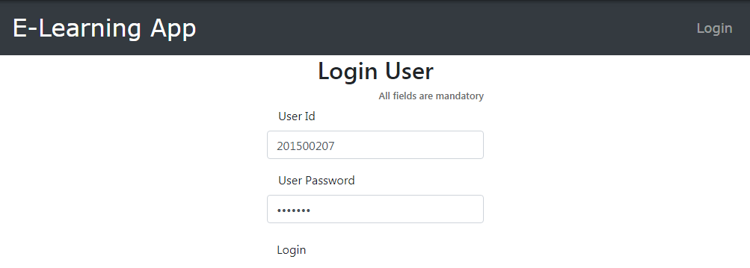
Fig. 7.1 Registration page
Fig. 7.2 Login page

Slide 13
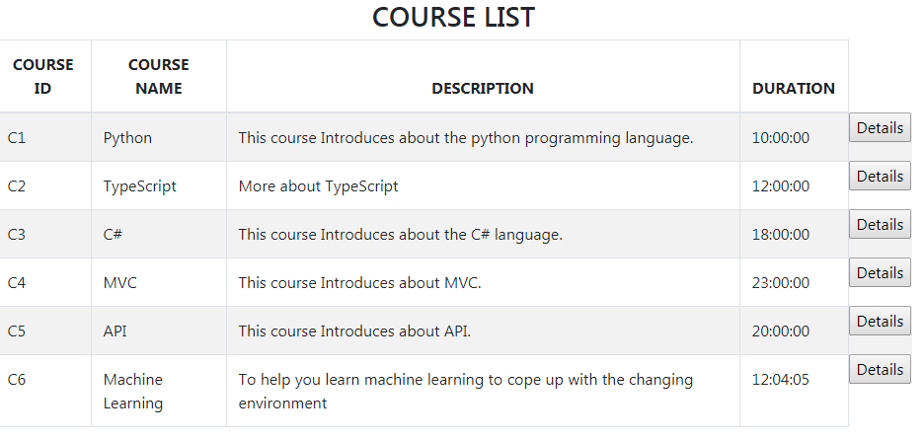
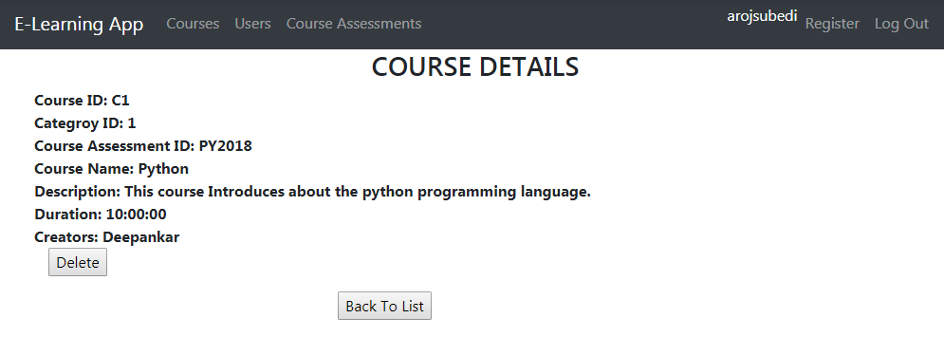
2. List Courses and View details –
Both admin and users will be able to view the list of courses and their details.
The user will be able to opt for the course. In that case the course will be added to ‘My Course’ section of that user.
The admin will be able to view, update and delete the course details.
Fig.7.3 List of Courses
Fig. 7.4 Course Details

Slide 14
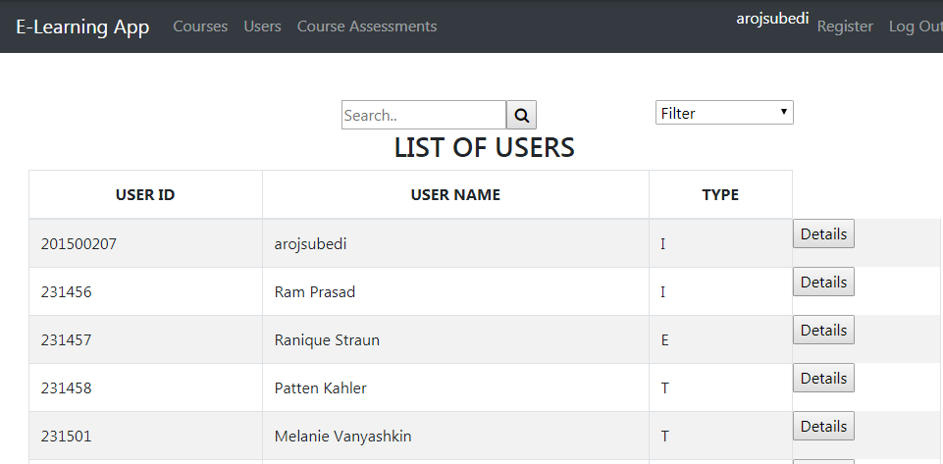
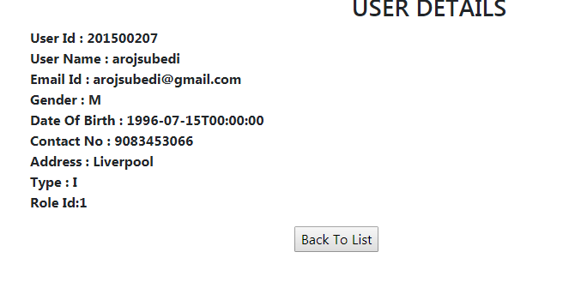
3. List Users and View details –
Only admin will be able to view the list of users and their details.
The users will be able to view or update his/her details.
The admin will be able to view and delete the user details.
Fig. 7.5 List of Users
Fig. 7.6 User details

Slide 15
4.Searching and filtering
Both users and admin will be able to search and filter in the users and courses list.
The search parameter in the user list can be either User Id or User’s name and the implemented searching function in the data access layer searches for the sub-string of the search parameter in the database and fetches the details.
The search parameter in the course list can be either Course Id or Course’s name and the search is done in similar manner.
The filter in the User list is done using the User Id or User’s name in both ascending as well as descending order.
The filter in the Course list can be done using Course Id or Course name in both ascending as well as descending order.

Slide 16
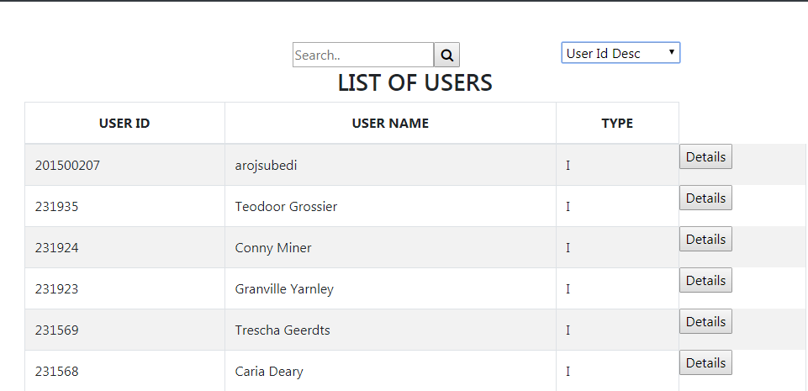
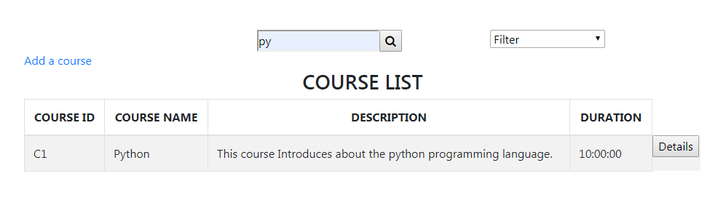
Fig. 7.7 Filtering the user list
Fig. 7.8 Course details fetched using search parameter

Slide 17
Thank You

